Slide 1
Consuming Data from Multiple Sources
Beth Wolfset
Notes:
In a custom app, data portal, query or reporting tool, everyone wants to use consume data from multiple sources. This session will discuss several ways that data can be managed and queried from multiple data sources. This will include traditional copy of data to one DB, remote querying, data lake use of data sharing, and data mesh.

Slide 2
About Beth
Email: beth.wolfset@insight.com bswolfset@gmail.com
Twitter: @beth_wolfset
Repo: https://github.com/BSWolfset/PresentationSlidedecks
Senior Data Architect with Insight for 7+ years
Worked with data for 30+ years
Healthcare data for 25+ years
Skills : data architecture, analysis, data modeling & design, data engineering, data management, data governance
Presenter at multiple conferences, events, user groups
Mentor at hackathons and events encouraging diversity in STEM
Organizer of NE GiveCamp

Slide 3






About Insight Enterprises
www.insight.com
Modern Workplace
Create a productive, flexible, and secure workplace.
Intelligent Edge
Gather and utilize data in the most efficient way possible to enable real-time decision-making and affect pivotal outcomes.
Our services
Consulting Services
Create competitive advantage and improve operations by aligning business goals to IT and product strategies.
Our
expertise
Modern Apps
Create new product experiences and transform legacy applications to drive increased business value.
Data and AI
Leverage analytics and AI to transform business operations and user experiences.
Hardware, Software, and Lifecycle Services
Simplify supply chain and streamline costs across the global hardware and software lifecycle.
Modern Infrastructure
Architect and modernize multicloud and networking solutions to drive business transformation.
Cybersecurity
Mitigate risks and secure business assets.
Managed Services
Eliminate business disruption and strategically align resources.
Notes:
Insight is a global, Fortune 500 solutions integrator committed to helping organizations navigate any kind of digital transformation by focusing on not only the technology aspect but the people and processes as well
We have an extensive partner ecosystem so our clients only have to work with 1 vendor no matter the size of their project and our client-focused approach ensures the most appropriate solutions to drive digital transformation and modernization for innovation

Slide 4
Agenda
Data Architectures & Definitions
Remote Querying
Traditional Data Architecture
Data Warehouse
Modern Data Architecture
Data lake
Lake House
Data fabric
Data mesh
Summary
Data Catalog
Definition
Analogy
Comparisons
Examples
Agenda
Databricks
LENS Data Warehouse
Custom Build

Slide 5
Remote Query
Querying from computer database to source db
Performance can be poor due to copying data from remote database to driving database
SQL Server Linked Servers – between Microsoft DBs
SELECT * FROM linkserver.db.dbo.table
tSQL Open Query – sends query as a string between DBMSs
SELECT * FROM OPENQUERY(linkserver, ‘select * From db.dbo.table’)
Also OPENDATASOURCE and OPENROWSET
Oracle DB Link – between Oracle DBs or other DBMS (using heterogeneous services)
SELECT * FROM dbo.table@dblink
SQL
Server
Driving Database
Oracle
Linked Server
or Open Query
Open Query
DB Link
DB Link
SQL
Server
SQL
Server
Oracle
Oracle
Remote Databases
Oracle
Oracle
SQL
Server
SQL
Server
Notes:
Special permissions and configurations are required to make these available
Optimizer is stupid and will bring everything in remote db over to driving db and then do all the joins and filtering on the driving database. No ability to perform query push-down – ability to force the work to be done local to the Db with the tables.
To support performance, minimize the data that is carried across the link. This may be done by calling a view or stored procedure on the remote database that forces the work to be local to the data.
Enterprise gateway works similarly to a Linked Server or DB Link

Slide 6


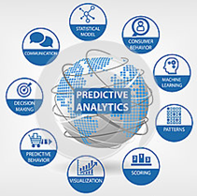
Traditional Data Architecture
Copy data from multiple sources to one DB
SQL Server Reporting Services (SSRS)
SQL Server
SQL Server Integration Services (SSIS)
SQL Server Analysis Services (SSAS)
Power BI
Transactional Source systems
ETL
Data Warehouse
BI & Analytics
Staging
OLTP
ERP
CRM
LOB
Historical
Reporting
Dashboards
IoT Data
Logs
Azure Machine Learning (AML)
HD Insight
Devices
Web
Sensors
Social
Predictive Analytics
Data Warehouse
Centralized repository
Stores Structured and semi-structured data, conformed
Supports reporting and analysis, data mining, data visualization
Notes:
Slide is a modification of Microsoft Slide that is found in several presentations : https://mva.microsoft.com/en-US/training-courses/big-data-analytics-with-hdinsight-hadoop-on-azure-10551?l=WZjfYu97_7404984382
Predictive Analytics from dreamstime.com

Slide 7
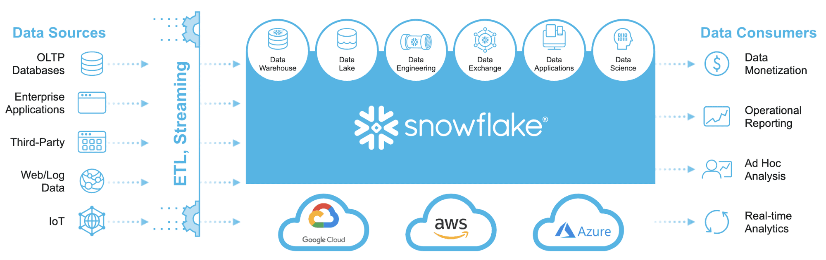
The Modern Data Warehouse
An integrated platform that provides analytic capabilities required to achieve tactical and strategic analytic goals for an organization.

Slide 8
Data Lake and MPP Databases
Data Lake
Centralized repository, scalable, flexible
Store, process and secure large amounts of structured and unstructured data
Store data in native format, or conformed
Support Data Science, AI / ML
MPP Databases
Databricks, Snowflake, Synapse, Amazon Redshift are considered Massively Parallel Processing Databases
NoSQL Databases
Support Big Data
Volume
Velocity
Variety
Veracity
Separate storage and compute
Compute can be adjusted for processing needs
Processing is done in parallel

Slide 9
Types of Databases
Database Type | Example
Relational (SQL) | SQL Server SQL Database Oracle Sybase MySQL MS Access
MPP | Databricks Snowflake Synapse
Document | Lotus Notes CouchBase CouchDB MongoDB OrientDB Raven Terrastore Azure DocumentDB Azure Cosmos DB
Database Type | Example
Key-Value | Berkely Level Memcached Riak Redis Azure Tables
Column-Family | Cassandra HBase Hypertable Amazon Simple DB
Graph & Resource Description Framework (RDF) | Neo4J Flock HyperGraph Infinite Graph Jena Sesame AllegoGraph MS Graph
Database Type | Example
Hierarchical | MUMPS IMS Adabas Datatrieve
Search Engine | ElasticSearch Splunk Solr MarkLogic Sphinx
Object-Oriented | Cache ObjectStore Objectivity/DB Db4o Versant
Types considered NO SQL
Products offered by Microsoft
Notes:
Data appliances are not shown

Slide 10


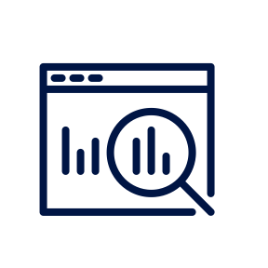

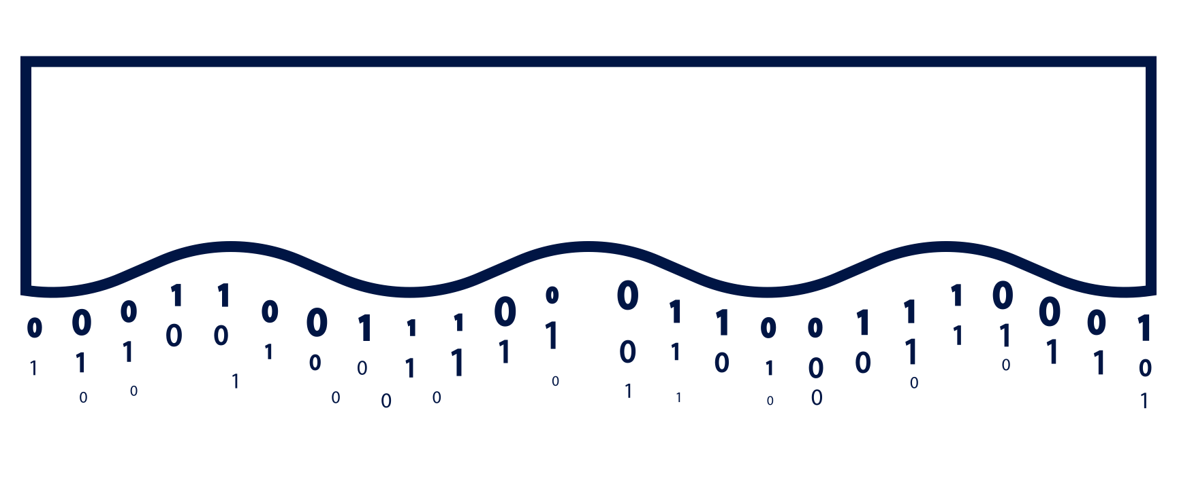

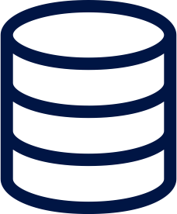




Lakehouse with Databricks
Combines data warehouse and data lake
Centralized repository
Unified governance and data
Structured and unstructured data
Performant
Scalable and fexible
Supports reporting and analysis, data mining, data visualization
Support Data Science, AI / ML
One platform for every use case
Streaming Analytics
BI
Data Science
Machine Learning
DELTA ENGINE
High performance query engine
Structured transactional layer
Data Lake for all your data
Structured
Semi-Structured
Unstructured
Notes:
Key Takeaways:
Here’s how the entire solution comes together with our Unified Data Analytics Platform
The focus is on enabling your data teams to be productive and help them harness all your data
Data Science, Machine Learning, and Analytics on one cloud platform
Build an open data lake with Delta once and leverage it for all your use cases multiple times
Securely integrates with your cloud ecosystem be it AWS or Azure
Detailed Talk Track:
When you put this all together, I call this the layer cake slide. If we go from the bottom to the top let's summarize what Databricks is. Like I said in the first slide, Databricks is a managed service on AWS or Azure. Everything that I just spoke about, you can have deployed in your AWS environment or in your Azure environment with a couple clicks of the button. It's one install that takes seriously a couple of clicks of the button.
Next we have managed Delta Lake so you don't have to change your architecture. You'll leave your data where it is and you just apply the Delta format and then you'll get all the benefits that we talked about within Delta Lake.
On top of Delta Lake, we have Delta engine which brings high performance to all your data workloads. It includes all the performance optimizations that you would expect in a data warehouse.
The final layer is focussed on providing a purpose-built user interface for analytics data science and machine learning. Redash provides a first class interface for SQL analysts to analyze data and share insights through reports and dashboards. We also provide those optimized connectors to your BI clients. If you're using Tableau, know that we're not just using the regular JDBC or ODBC client. We have an optimized client that makes your setup of that easier and your queries to run more performant.
For data science teams we have a collaborative workspace that is fully integrated with MLflow. Think about the Data Science Workspace as the portal that your users go into. From configuring clusters (making sure that you've clicked the button for runtime database, runtime for ML so your data scientists have the right frameworks installed on your nodes of your clusters) to a managed MLflow registry and tracking server, to a notebook environment that is either our notebooks, Jupiter or any other IDE that you want to leverage, is all supported within the Databricks environment.
Access once, query with any client.

Slide 11
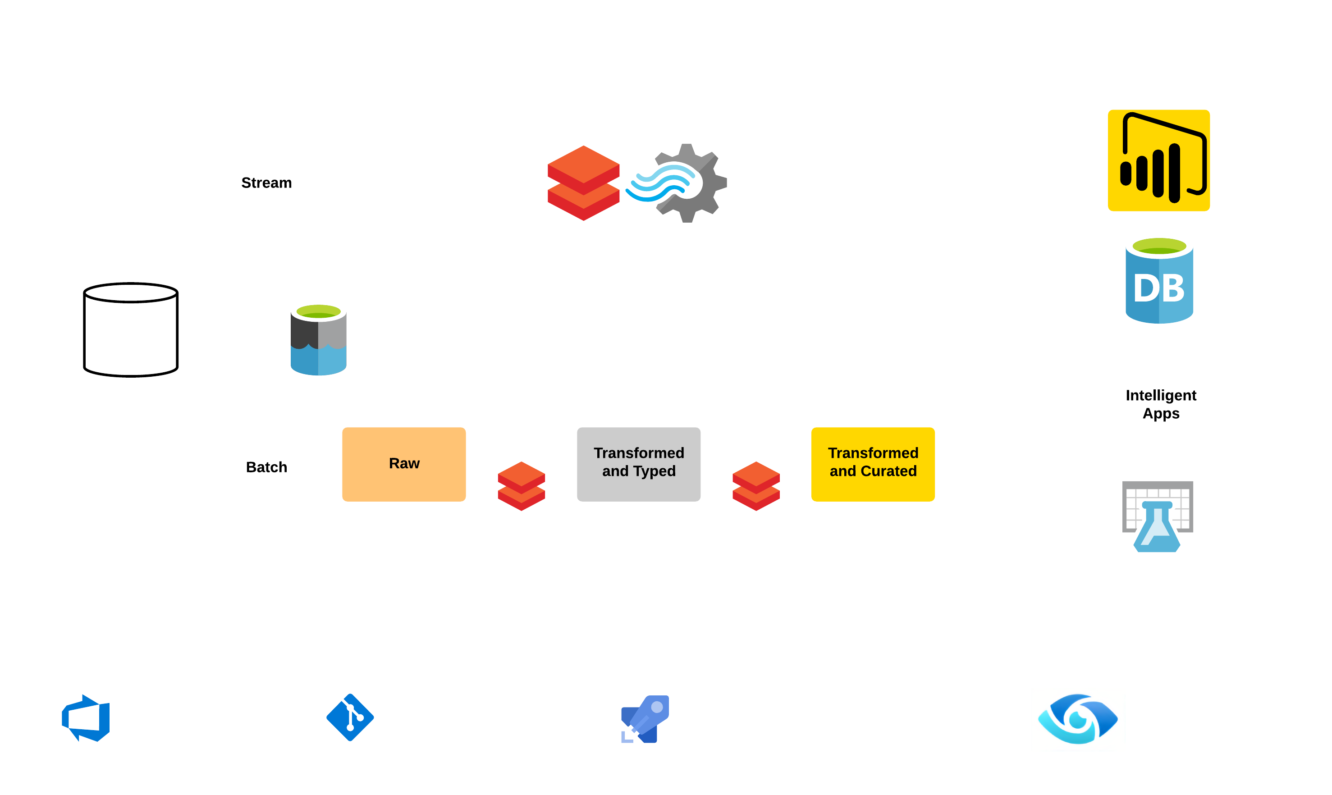

Modern Data Architecture
Bronze
Silver
Gold
Unity
Catalog
Notes:
The modern data architcture still brings together a variety of sources. However, these can be structured, unstructured and big data. The data is brought into the cloud and can use a variety of storage include Data Lake and MPP systems for accessing the data.
Sources:
As an enterprise system of record for business processes, the data warehouse is mostly built over line-of-business data sources.
Whether that data is unstructured, structured, or semi-structured, the modern data architecture can handle it.
Other, more volatile sources are often used for data science, or for ad-hoc analysis.
Ingestion:
Azure Data Factory schedules and orchestrates data transformations and bulk loads. Ingestion can also use Azure Synapse Studio pipelines. Azure Databricks performs transformations specifically for data science and also builds and executes models. Scores from these models may be loaded into the data warehouse, to integrate these insights with enterprise applications and reports.
Storage:
Azure Data Lake may be used to store raw data in high volume for later use, along with staging transformed data from Azure Databricks.
Azure Synapse Analytics provides high-performance, highly-scalable data storage for enterprise models, with outstanding security, governance and manageability.
Reporting:
Power BI consumes enterprise data from the data warehouse for reporting and analytics, but may also use data from the data lake for ad-hoc analysis and integrating with data science
Many business services, including line-of-business applications, consume data from the data warehouse as an authoritative, governed, source of enterprise knowledge.

Slide 12
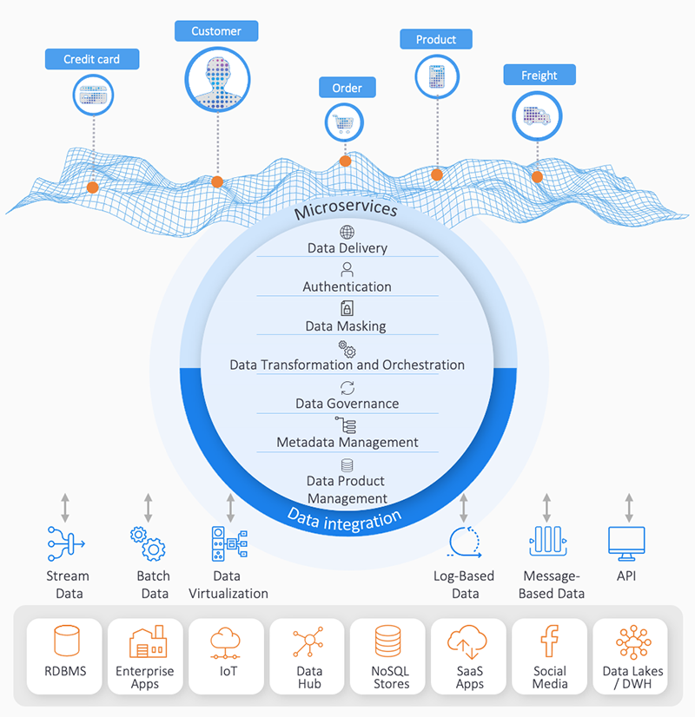
What is Data Fabric?
Data fabric refers to an architecture that allows data to be easily and seamlessly accessed, managed, and shared across an organization's IT infrastructure. It is a unified and integrated approach to manage data that spans on-premises and cloud environments.
Technology-centric
Data is managed and available centrally
Carries structured and unstructured data
Scalable and Flexible
Handles reporting and analytics
Supports Data Science, AI and ML
Notes:
Data fabric provides a layer of abstraction that sits between various data sources and consumption points, providing a consistent view of the data regardless of where it resides. It helps organizations manage data in a more efficient and effective way, making it easier to use data for analytics, decision-making, and other business purposes. Data fabric can include various components such as data integration tools, data management software, data governance policies, and security measures. It is becoming increasingly important as more organizations adopt cloud-based solutions and work with large volumes of data from different sources.
Technology-centric view
Data is centralized or made available centrally

Slide 13
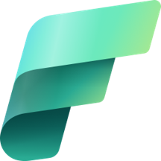

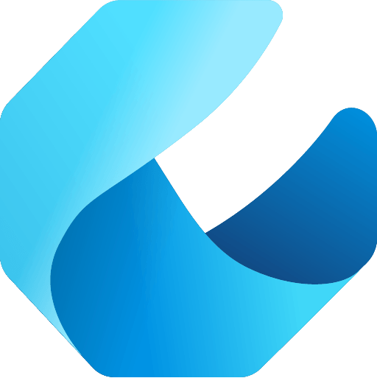
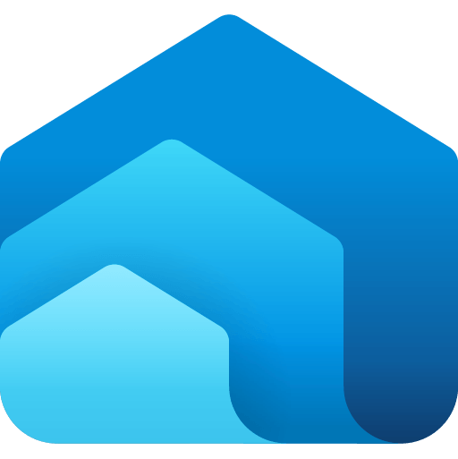
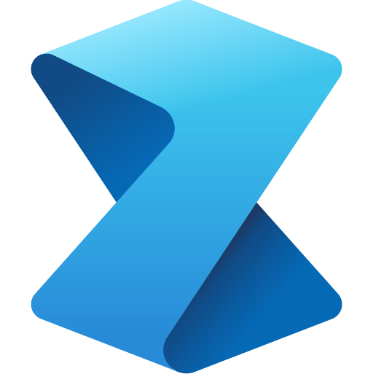

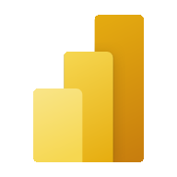


Microsoft Fabric does it all - in a unified solution
Announced at MS Build May 2023
Data ecosystem
Aligns to Data Mesh principles
Familiar foundation
Improved the portfolio of PaaS services and “SaaSified” them
End result is an integrated, SaaS platform covering the spectrum of data capabilities
Minimal configuration/administration
Data Integration
Data Engineering
Data Warehouse
Data Science
Real Time Analytics
Business Intelligence
Observability
Data Factory
Synapse
Synapse
Synapse
Synapse
Power BI
Data Activator
Unified data foundation
OneLake
UNIFIED
SaaS product experience
Security and governance
Compute and storage
Business model
Notes:
Microsoft Fabric combines Data Factory, Synapse Analytics, Data Explorer, and Power BI into a single, unified experience, on the cloud. The open and governed data lakehouse foundation is a cost-effective and performance-optimized fabric for business intelligence, machine learning, and AI workloads at any scale. It is the foundation for migrating and modernizing existing analytics solutions, whether this be data appliances or traditional data warehouses.
Talk Track for Greenfield/Growing Analytics Customers – Microsoft Fabric’s SaaS environment makes it easier to deploy an entire end-to-end analytics engine from the ground up at an accelerated pace. With the solution’s built-in security and governance capabilities, you can be rest assured your data and insights are protected.
Talk Track for Existing Synapse Customers – Microsoft Fabric is an evolution of Azure Synapse. You will still be able to enjoy the benefits and limitless scale of Synapse in an easier to use SaaS solution while adopting new capabilities that enhance your entire analytics approach. And with the addition of Power BI, you can help democratize the ability to uncover insights and create interactive reports across the organization, helping everyone make more data-driven decisions in their everyday work.
Talk Track for Existing Power BI Customers – With Microsoft Fabric, you’ll be able to access new and powerful data tools and services like Azure Synapse within the same user experience you already enjoy with Power BI. You can unify these tools with your disparate data sources in the same environment to establish a single source of truth for all data, driving the ability for everyone to uncover more accurate and consistent insights than before. And instead of having to worry about security concerns of a patchwork analytics estate, you can be rest assured your data is protected with the built-in security and governance capabilities.

Slide 14
What is Data Mesh?
Data mesh is an approach to building a decentralized analytics architecture where business domains are responsible for their data – giving ownership to the group that’s closest to and best understands the data.
Successful data mesh requires:
Flexibility and agility
Governance
Abstract technical complexity
Products : Starburst, K2View, Talend, Informatica, Denodo
All major data vendors claim to have a data mesh solution
Domain-driven Distributed Architecture
Data as a Product
Self-serve Data Infrastructure as a Service
Notes:
Data Mesh is less about an architecture and more about how to approach building and managing data outputs.
It’s a decentralized model where business domains are responsible for their own data and outputs. It makes sense as they’re the one that are closest to the data and understand it best.
If we’re going to be successful with a data mesh approach, we need to be agile, drive governance and remove technical complexity from the consumer.

Slide 15
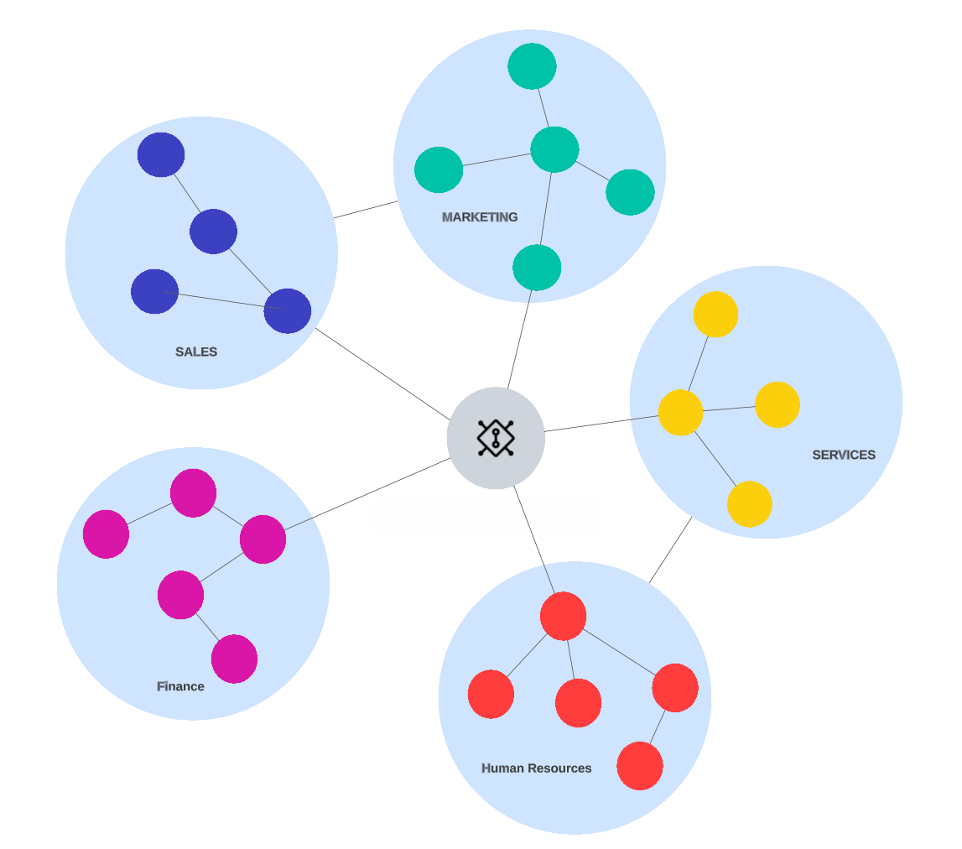
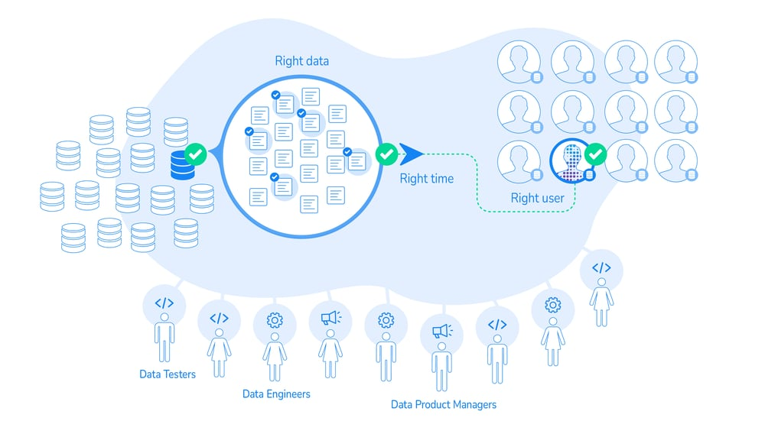
Data Mesh Features
Domain-driven Distributed Architecture
Centralized models force a universal pipeline for all
With Data Mesh, a domain owns pipeline development/maintenance
What is a Domain?
How are we not creating silos with this approach?
Marketing
Sales
Services
Human
Resource
Finance
Data as a Product
In the centralized model, data is thought of as units flowing through pipelines.
In the Data Mesh world, data is thought of as a first-class citizen and viewed as a product.
A data product Must be FAIR :
Findable, Accessible, Interoperable, Reusable
Notes:
In the centralized model…the pipeline is universal for all business domains.
In the data mesh architecture, the distribution of data is domain-driven. Each domain takes ownership over the production and maintenance of its own data pipelines.
What are domains? Domains are areas of common data needs and visions. Usually, data-driven domains map to business domains. For example, the finance department would have its data-driven domain, while the marketing department would have a separate one.
How does this architecture differ from siloed data? Domain-driven distributed architecture is not siloed. As pictured above by lines connecting domains, domains converge, sync, and collaborate when:
The source data is shared among domains to avoid duplication.
The end product of a domain is shared among the domains.

Slide 16
Summary of Data Architectures
Feature | Data Warehouse | Data Lake | Data Lakehouse | Data Fabric | Data Mesh
Repository | Centralized | Centralized | Centralized | Decentralized | Decentralized
Management and Access | Centralized | Centralized | Centralized | Centralized | Centralized
Structured, Semi-structured | X | X | X | X | X
Unstructured, Native Format |  | X | X | X | X
Big Data & Flexible | X | X | X | X | X
Scalable |  | X | X | X | X
Domain Driven | Data Marts |  |  |  | X
BI / Reporting and Analytics | X | X | X | X | X
Data Science and AI / ML |  | X | X | X | X

Slide 17
Data Catalog
Inventory of data assets
Allows for registration, browsing and tagging/classification of data assets
Provide a unified view of the data
Enterprise wide or by business unit
Inclusive of a data dictionary
Support data lineage, data discovery, data profiling, data definitions
May support metadata management, business definitions and data governance
Support automated data discovery by scanning
May support automated data lineage discovery by scanning pipelines
Notes:
A data dictionary is a part of every DBMS. It supports the data organization (tables and columns), data formats, nullability, primary and foreign keys. It may support data definitions.
Data catalogs are broader than a data dictionary, but do no usually meet all needs for data governance.
A data dictionary, and a data catalog, usually do not support data diagrams. Although some products will integrate with a data diagramming (ER diagramming) tool

Slide 18
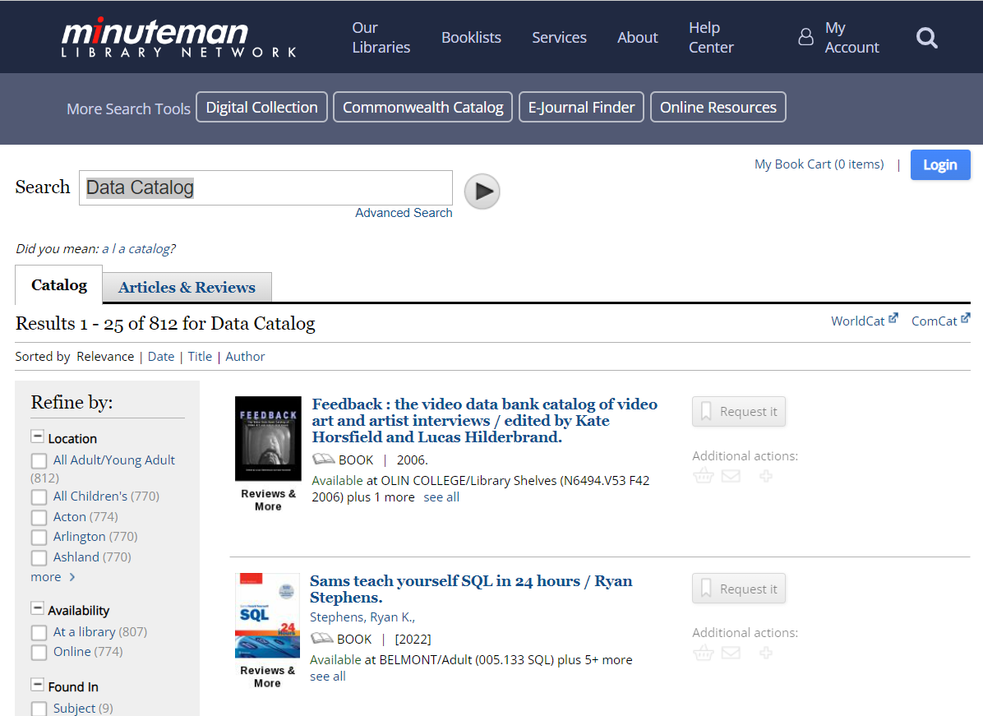

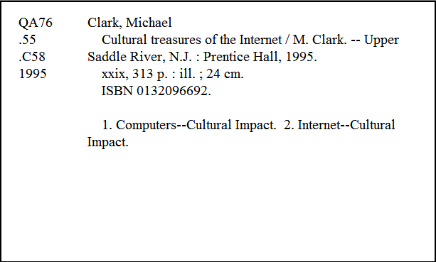
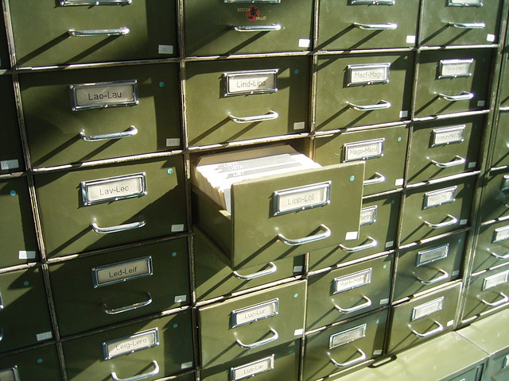
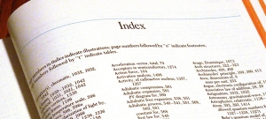
Card Catalog vs Data Catalog
Notes:
Any organization has many databases, just like books in a library.
Even within the book, there are many pages and topics. You turn to the index to get a quicker access to the topic.
The databases have multiple subject areas and tables. If I don’t know these systems, how does someone find what they need?
Before libraries were computerized, they were organized using a card catalog
The card catalogs were freestanding and arranged alphabetically. A book would have two cards, one placed by the titles and another placed alphabetically for the author.
A card in the catalog had the title, author, Dewey decimal number for the book (which tells you how to find it in the library), genre/subject, publishing information, physical description of the book and alternative ways to get to that subject.
In other words, the card catalogs held the metadata about the book.

Slide 19
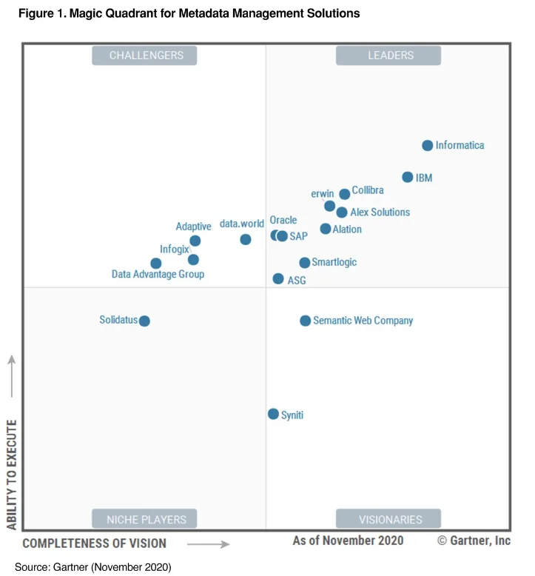
Data Catalog Tools Comparison
Feature | Microsoft Purview | Unity Catalog | Informatica EDC | Idera Team Edition | Collibra | Alation | Data. World
Review Type | PoC | Use | PoC | Use | PoC | PoC | Literature
Review Date | 1/2021 | 9/2023 | 2/2020 | 5/2019 | 1/2021 | 2/2021 | 11/2019
Maturity | 2021 | 4/2022 | Version 10.3 | Version 18.5 | 2008 | 2017 | 2017
Cost | $$ | $ | $$$ | $$ | $$$$ | $$
Platform | Azure Subscription | Databricks region | On-Prem/VM | On-Prem | Both | Both | Hosted
Data Sources | Many | Limited to databricks connection | Licensing | Many | Many | Licensing | Some
Auto Scan | Yes | Derived from Job execution | Yes | No |  | Yes
Data Model Diagram | No | No | No | Yes
Data Dictionary | Yes | Yes | Yes | Yes | Yes | Yes | Yes
Business Glossary | Yes | No | Yes | Yes | Yes | Yes | Yes
Tagging | Yes | Yes | Yes | Yes | Yes | Yes | Yes
Data Lineage | Yes | Yes | Yes | Yes | Yes | Yes | No
Installation | NA | NA | Complex | Moderate | Simple |  | NA
Notes:
There are a lot of products out there. This is a slide from 2021 that has been partially updated.
Other vendors in this space : Erwin (Quest), Alex, IBM, Oracle, SAP. There are more recent Gartner magic quadrant but was able to get this one from 2020.

Slide 20
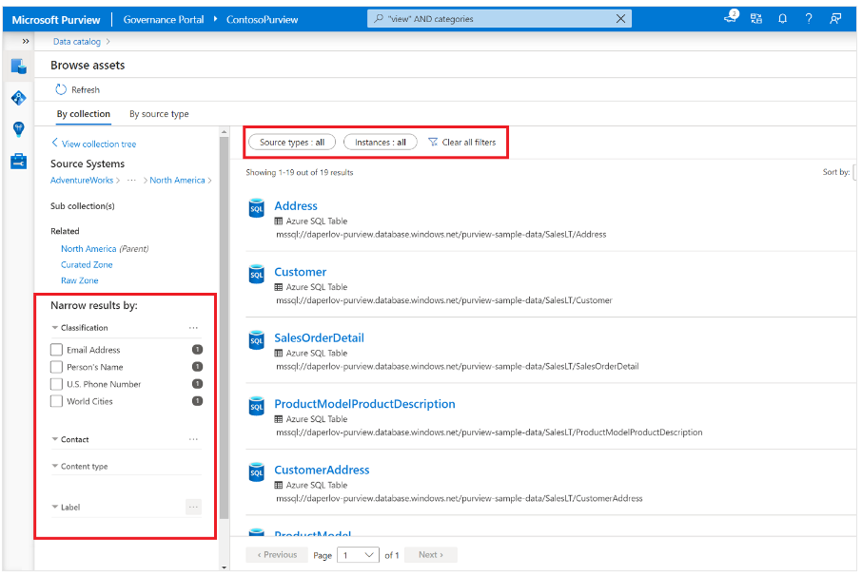
Microsoft Purview

Slide 21
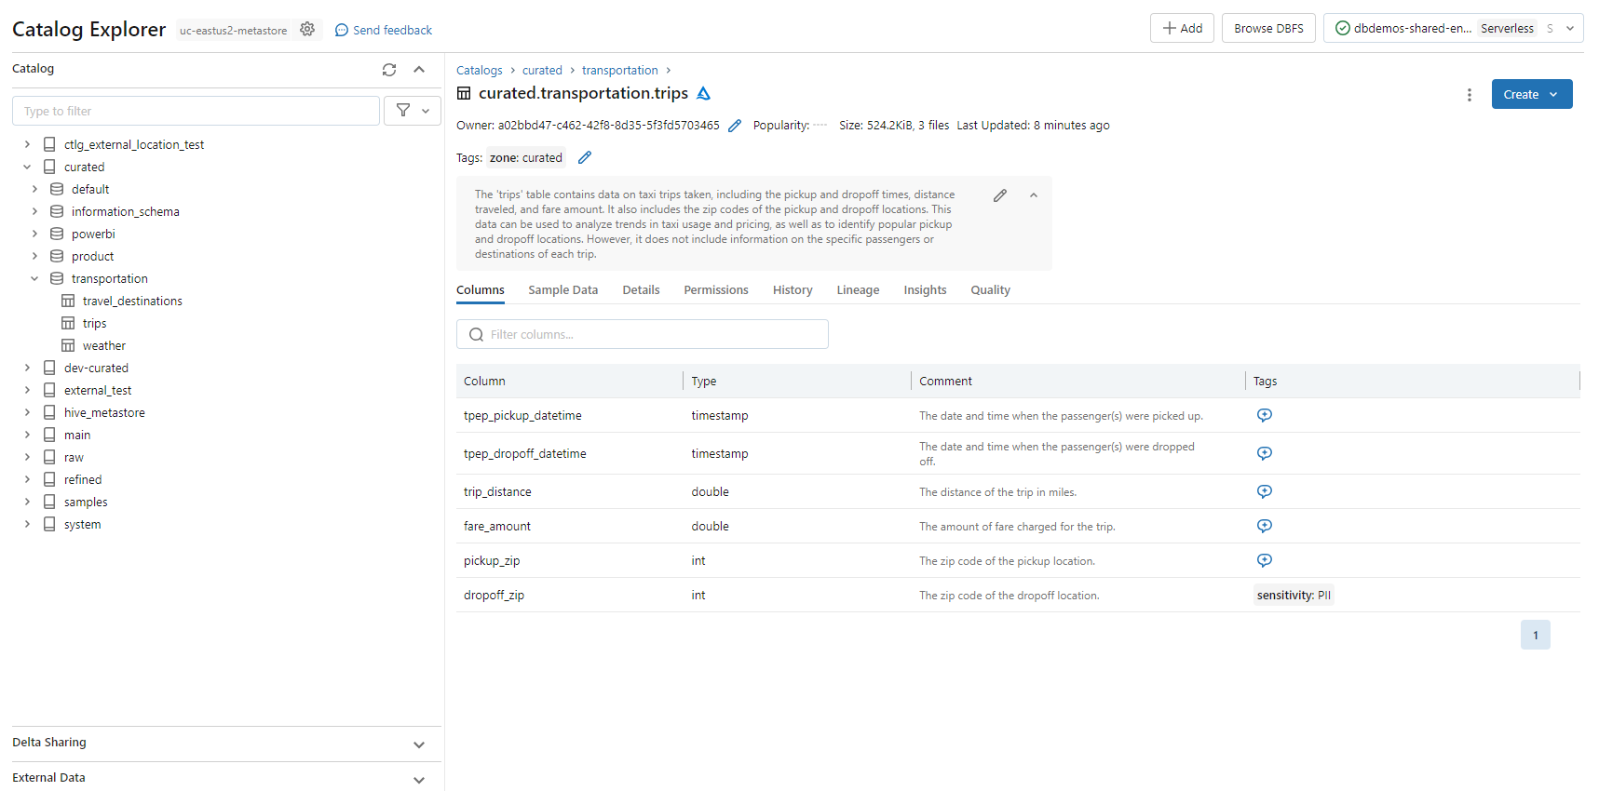
Databricks Unity Catalog
Notes:
Samples from perview and unity catalog

Slide 22
Thank You
Beth Wolfset
Senior Data Architect – Manager Data Practice, NE
Email: beth.wolfset@insight.com bswolfset@gmail.com
Twitter: @beth_wolfset
Repo: https://github.com/BSWolfset/PresentationSlidedecks

